Slide 1





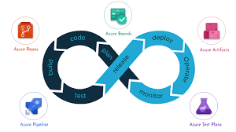




System Administration - Basics

Slide 2
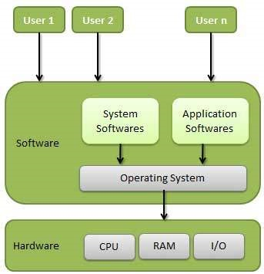
Operating System ?
An operating system (OS) is system software that manages computer hardware, software resources,
and provides common services for computer programs.

Slide 3





Common Operating Systems
Microsoft windows
Linux
Apple Macinthosh OS
Apple iphone OS
Android

Slide 4
Microsoft Windows OS
Windows is a graphical operating system developed by Microsoft. It allows users to view and store files, run the software, play games,
watch videos, and provides a way to connect to the internet. It was released for both home computing and professional works.
Popular Versions of Windows OS
Client – Windows7, Windows8, Windows10, windows11
Server – Windows2000, Windows2003, 2008, 2012, 2016, 2019
To connect Windows Server we use Remote Desktop service
Default port is 3389

Slide 5
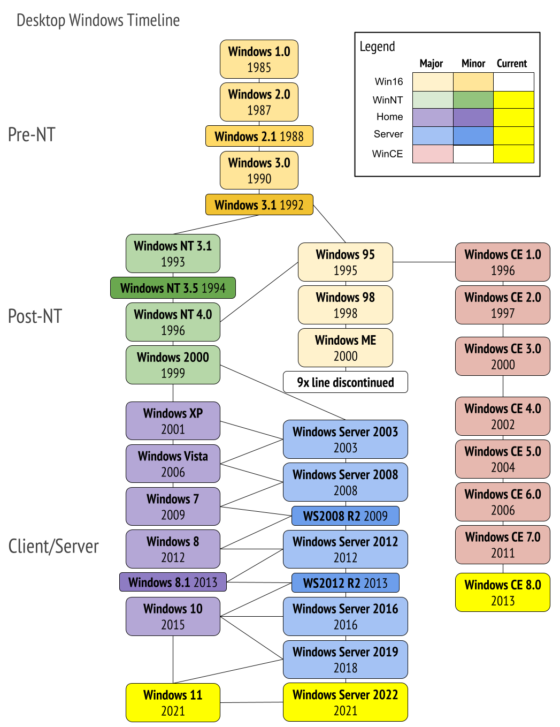
Versions of Windows OS

Slide 6
Service management in Windows OS – services.msc
Command Prompt:
PowerShell
Command | Function
sc config | Configures service startup and login accounts
sc continue | Resumes a paused service
sc enumdepend | Lists the services that cannot run unless the specified service is running
sc failure | Specifies what action to take upon failure of the service
sc pause | Pauses a service
sc qc | Displays the configuration of a particular service
sc query | Displays information about the specified service, driver, type of service, or type of driver
sc start | Starts a service running
sc stop | Sends a STOP request to a service (not all will respond)
Command Function
Get-Service allows to get the services on a local or remote computer
both in running or stopped state;
New-Service creates a service. The cmdlet creates a new entry for a Windows service
in the registry and in the service database;
Restart-Service restarts a service. The cmdlet sends the restart message through
the Windows Service Controller;
Resume-Service resumes a service. The cmdlet sends a resume message
to Windows Service Manager;
Set-Service changes the settings of a local or remote service, including its state, description,
displayed name or startup mode. You can also use this cmdlet
to start, stop or suspend a service;
Start-Service starts a service;
Stop-Service stops a service (the cmdlet sends a stopping message to Windows Service Manager);
Suspend-Service suspends a service. A suspended service is still running,
but it does not do anything till it is resumed using
( for example, with the Resume-Service cmdlet).

Slide 7
Local User management in Windows OS – lusrmgr.msc
Command Prompt:
PowerShell
Command | Function
net user | To list the user names having account on the local system
net localgroup | To list the group names having account on the local system
net user username password /ADD | To add a new user account on the local computer
net user /add John * | To add a new user account on the local computer without password visible
net localgroup group_name UserLoginName /add | To add new localgroup
net user username | findstr /B /C:"Last logon" | To list last time login of user
Net user John /active:no | To disable user account
Command Function
Get-LocalUser To List local user
Get-LocalGroup To list Local group names
New-LocalUser To create new user
Add-LocalGroupMember To add new Group

Slide 8
File management in Windows OS
Command Prompt:
Command Function
cd/chdir change directory
copy This command copies a specified file to a given location
del/erase deletes a file or number of files
dir displays the current files and folder
find searches a specific file for a given string.
md/mkdir creates a new directory
move copy/paste command that move a file from one location to another
ren/rename to rename directories
rd/rmdir to remove a directory
tree Displays a graphical file tree of the the specified file path, or the current drive if no path is specified.

Slide 9
Network commands
command Function
ping The Ping command allows you to test the reachability of a device on a network.
IPconfig displays basic IP address configuration information for the Windows device you are working on
hostname display the current name of your computer
nslookup Displays information that you can use to diagnose DomainName System (DNS) infrastructure
tracert This command will trace the route a data packet takes before reaching its destination, displaying information on each hop along the route
netstat The Netstat command displays active TCP connections, ports on which the computer is listening
systeminfo Displays a detailed list of configuration information about your computer

Slide 10
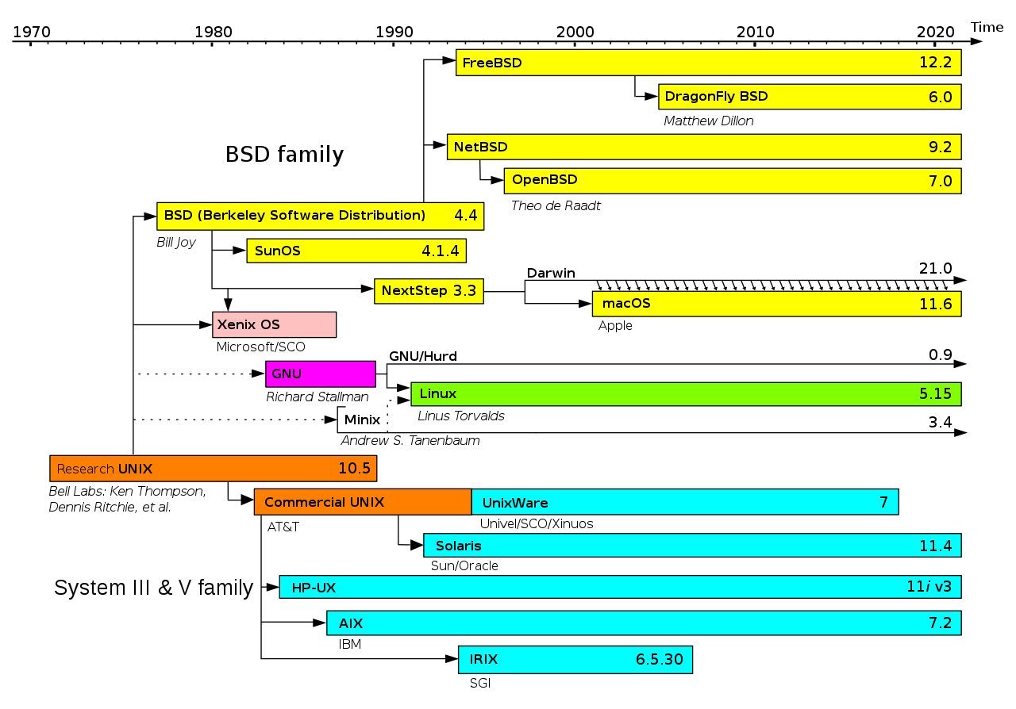
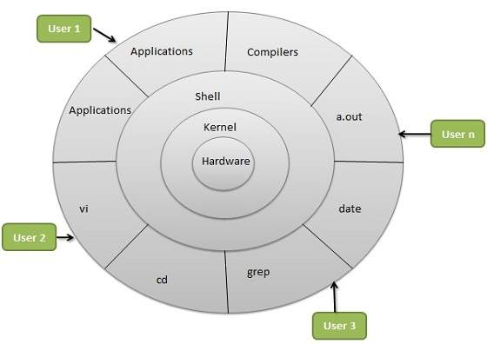
Linux Operating System
Architecture

Slide 11
Linux Operating System
Components
Hardware layer: This layer comprises all the peripheral devices such as (RAM/ HDD/ CPU etc.).
Kernel: It is Linux's main component and is also in charge of many of the LINUX operating system's functions.
It communicates with hardware directly and delivers low-level operations to upper-layer elements.
Shell/GCC: It is a user-to-kernel interface that hides the complexities of the kernel's operations from users.
Shell processes the user's command and performs the kernel's functions.
Application Software: The desktop environment that comes with your Linux OS or that you choose to install will not be able to meet all of your application requirements;
there are far too many. Therefore, individual applications are installed.
Most Linux distributions, such as ubuntu, come with dedicated app stores to find and install the software.
Bootloader: Computers go through a startup process known as booting. This boot process requires instruction, and your operating system is in charge of it.
The bootloader for your operating system precedes the process when you turn on your computer.
Background services: Also known as "daemons," these small systems serve as workers in the background, assuring that critical tasks such as scheduling, publishing,
and multimedia work properly. They begin to run once the user logs in into the computer or right after the system gets booted.

Slide 12







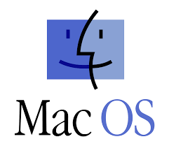
Linux Operating System
Unix
Linux

Slide 13
Linux Operating System
Different Shells in Linux
Bourne Shell -
C Shell – Default prompt is ‘%’ and root user prompt is ‘#’
Bourne Again Shell(bash) – Default prompt is ‘$’ and root user prompt is ‘#’
Fish – Friendly interactive shell
Korn Shell
zsh

Slide 14
Linux Operating System
Commands
pwd – Display current working directory
mkdir – Create new directory
cd -- change directory
cd - -- toggle between last two directories
grep – search a file for a specific text
find – search files in Linux/Unix file system
sed s// -- substitute word in a file
chmod – permissions on the file
chmod –R – permissions on files in directory
tail – get bottom lines of a file
head – get first lines of a file
wget – download file from internet
curl – browse url in command prompt
cat – display the contents
cat /etc/ssh/sshd_config – display the contents of a file.
date '+Current Date: %m/%d/%y%nCurrent Time:%H:%M:%S’ –
display date in particular format
tar cvf <filename>.tar <sourcefilename> - create tar(archive) files
of source file
tar xvf <filename>.tar – extract the tar files
history – list the previous commands
fdisk – create disk partition
mount – mount or attach disk partition to filesystem
useradd – create new user, check user exist in /etc/passwd
passwd – change the user password
groupadd – create new group
crontab – schedule the tasks
Iptables – firewall rules
yum – install, update, remove packages
<command> --help – to get the help for the commands

Slide 15
Thank you…!!!

